Slide 1

Domestic and Sexual Violence:
Trauma Informed Victim Contact and Interviewing
Neva Fernandez – Advocacy Manager
Texas Legal Services Center, Crime Victims Program

Slide 2

Trauma Informed Victim Contact and Interviewing: Objectives
Explore power & control
Define and explore “trauma informed”
Explore trauma informed victim contact
Practical tools for interviewing victims

Slide 3



Power and Control Wheel as the Batterer’s Toolbox

Slide 4
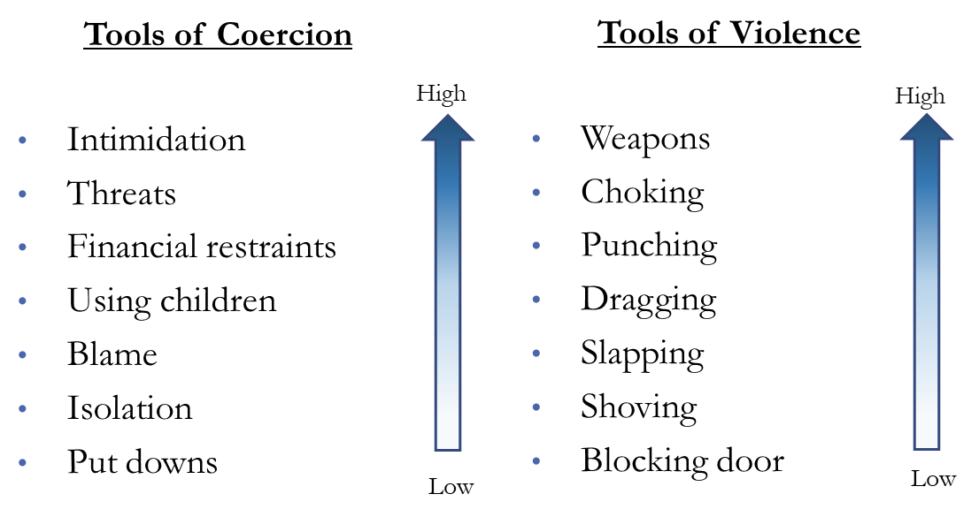
Power and Control Wheel as the Batterer’s Toolbox

Slide 5

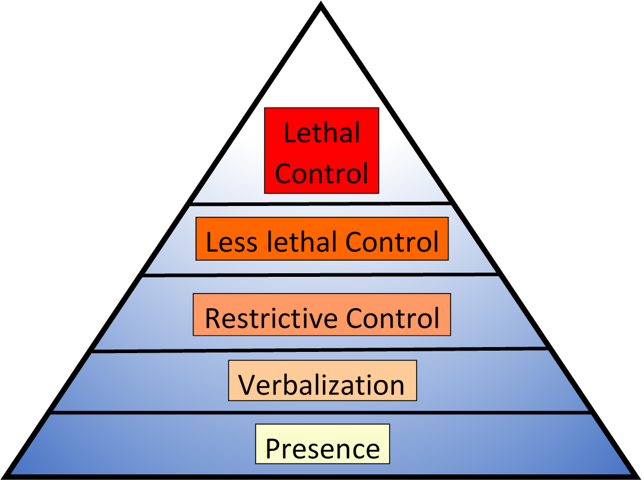

Use of Force
Lethal Control – Force that is life threatening
Less lethal Control – Force with impact but non-life threatening
Restrictive Control – Force is physical but non- impact
Verbalization — Force is not physical
Presence — No force is used

Slide 6
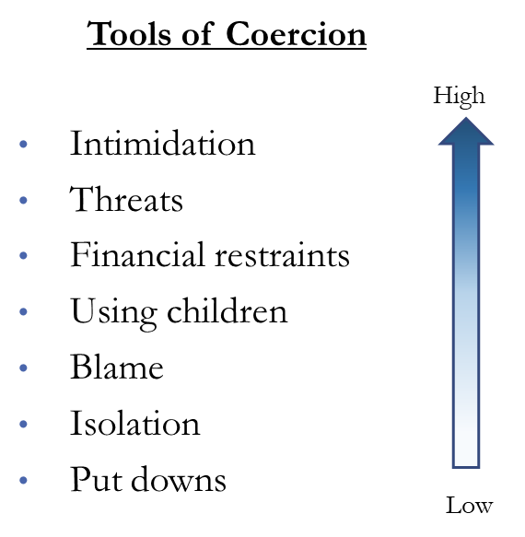
Batterer’s Toolbox and the Use of Force
  Tools of Violence
Weapons
Choking
Punching
Dragging
Slapping
Shoving
Blocking door
High
Low

Slide 7
Abuse as Rational Behavior from Why Does He Do That? By Lundy Bancroft
What is abuse?
What is not abuse?
Abuse is a tool
Abuse is goal-oriented
Abuse is rational IF you value your needs completely over someone else's
Abuse is not a loss of control
Abuse is not due to addiction
Abuse is not an “anger issue”

Slide 8
Trauma Informed
What is it and why do we care?

Slide 9

What is Trauma?
  An event that combines fear, horror, or terror with actual or perceived lack of control
Notes:
Thrillers at the movies… adults versus children

Slide 10

“Trauma Informed”
What is “trauma informed”?
  You know what effect trauma has on victims
  You are committed to not re-traumatizing the victim
Notes:
Neva

Slide 11

Being “Trauma Informed”
Why Bother?
  If you know what effect trauma has on individuals
      Then you’ll get more and better information
Notes:
Neva

Slide 12

Being “Trauma Informed”
Why Bother?
  If you are committed to not re-traumatizing the victim
      Then they will be a better witness, more willing to cooperate with law enforcement and be an ally in the community
Notes:
Neva

Slide 13

Being “Trauma Informed”
Why Bother?
  Bonus: It’s kinder
Notes:
Neva

Slide 14
Trauma and The Brain
Looking under the hood
*Thanks to Dr. Jim Hopper for assistance with this section

Slide 15


Trauma and The Brain
Executive System
  Rational thinking and planning
  Voluntary control of where attention is focused
  Voluntary control of behavior
Notes:
Voluntary control of behavior. Instead of
Responsible for extracting the gist of what happened when we retrieve information if they are stressed
Leads people to impose linearity where it doesn’t exist

Slide 16

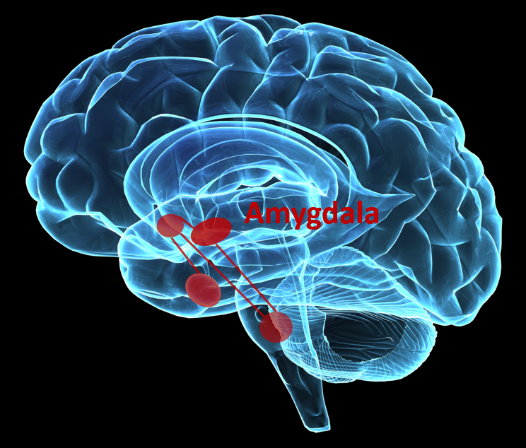
Trauma and The Brain
Defense System
  Automatically takes control
  Threat Responses
  Reflex and habit behaviors
Notes:
Limbic System

Slide 17




What happens when the defense circuitry detects a threat to survival?
Defense System
Executive System

Slide 18


What happens when the brain detects a threat?
Prefrontal Cortex is impaired
  Impaired planning
  Impaired ability to focus attention
  Impaired integration of memory
Notes:
This is what happens – next slide is what that means in practical terms

Slide 19
Threats to Survival and Memory
Prefrontal Cortex is impaired
  Impaired planning – Why didn’t you run, scream, fight?
  Impaired ability to focus – What color was his hair?
  Impaired integration of memory – What happened next?
✓ Memories captured are details to COPE or SURVIVE
Notes:
Neva

Slide 20
Threats to Survival
Defense system is largely in charge

Slide 21


What are our responses when the defense system is in charge?
With the defense system in charge, victims don’t usually get to choose their response:
  Reflexes
  Habits
    History &
    Culture
  Training
Notes:
Reflexes - freeze
Habits - polite

Slide 22
What does memory look like when the defense system is in charge?
Flashbulb Memory
  Detailed snapshot of the first moments of an assault
  Helps in prediction of future attacks
Fragmented Memory
  What do I need to focus on to cope or survive is saved but often without context or time stamp
  Memories can be fragmentary and disorganized, making them confusing later.

Slide 23

Trauma
In practice what does all this mean and what do we need to know to serve our clients?

Slide 24
Don’t prejudge! There ARE counterintuitive responses to trauma. They are NOT proof of deceit
Victim did not fight back
Victim showed no emotion when they talked about the assault
Victim seemed angry with the helpers (police, nurse, etc.)
Victim couldn’t remember what happened
Victim’s story changed
Victim displayed “inappropriate” emotions after the assault
Victim’s story was out of order
Victim didn’t report to police

Slide 25
What Can be a Sign of a Trauma Response?
Victim was difficult to follow and story did not flow linearly
Inconsistent statements – especially in the timeline and peripheral details not focused on during event
Emotional numbing and inability to feel physical pain.
Notes:
Neva

Slide 26
Key Takeaways about Trauma
Victim’s main drive during a traumatic event is survival and coping
During a traumatic event, the rational part of the brain is usually not in charge of the victim’s responses
Trauma can affect memory encoding, storage, and recall

Slide 27
Trauma Informed Interviewing
First: Meet Them Where They Are At

Slide 28
Is the victim not aware of or minimizing the problem?
  Adjust your expectations
  Affirm no one deserves to be hurt this way
  Build rapport for the future
  Encourage them to reach out to you again if they need anything in the future
Notes:
What’s your challenge? – Victim has normalized the violence and the power and control dynamics and is not looking to change

Slide 29
Is the victim ready to make changes but still attached to their batterer?
  Accept their continued love/sympathy/affection for the batterer
  Listen to what’s motivating them
  And then paint the choice
  Say those magic words: “This isn’t your fault”
Notes:
What’s your challenge? – The victim knows there is a problem but will often still identify with the batterer and seek to protect them

Slide 30
Trauma Informed Interviewing:
Techniques
The nuts and bolts

Slide 31
Start with questions that they know the answers to and that matter. These questions ground them and prime the pump - they can also build rapport.
Move to broad, general questions: “Tell me what happened last night.”
Ask them about how they felt and what they heard or smelled.
Listen for language clues and then drill down.

Slide 32
Focus on the senses
Ask them what they saw
1
Ask them what they heard
2
Ask them what they felt
3

Slide 33
Language Clues: What to Listen For #1
Language that minimizes what happened or
qualifies an action or event

Slide 34

Answers That Minimize
  Did he hit you?
    “Not really”
  Did you feel pain?“
    Not much”
  Do you have any injuries? “
    Not hardly”
  Could you breathe?
    “Sort of”

Slide 35
Language Clues: What to Listen For #2
Victims may use the passive voice or “I” to take responsibility away from the batterer.
Who is the “Doer?”

Slide 36
Example: “The gun went off.”
  Follow up question:
  “What were you feeling just before the gun went off?”

Slide 37
What Did Following up on the Passive Voice Tell Me?
  “The gun went off.”
    “What were you feeling just before the gun went off?”
      “I was worrying about my baby girl and if she would make it without me. He was saying he’d kill me and I knew I had to survive.”
What would you ask next?

Slide 38
Who is the “Doer?”
  Example: “I lost my balance and fell into the table.”
  Follow up question:
  “Do you remember what was happening when you lost your balance?”
Notes:
Victims may use the passive voice or “I” to take responsibility away from the batterer.

Slide 39
What Did Following up on the Who is the “doer” Tell Me?
  “I lost my balance and fell into the table.”
    “Do you remember what was happening when you lost your balance?”
      “He’d had his hand under my chin and when he let go, I had a hard time standing, so I fell.”
What would you ask next?

Slide 40
Language Clues: What to listen for #3
Explore the gaps in
  Physical location at the scene
  Bodily position at the scene
  Time
Notes:
Fragmented memory retrieval will create jumps from one moment to another. Catch these by catching changes in:

Slide 41
Gaps in Physical Place
  Example: “He was shaking me and I banged into the refrigerator. I fell by the couch and hit my head.”
  Follow up:
    “How did you feel when you went from the kitchen to the living room?”
    OR
    “What were you thinking when you went from the kitchen to the living room?”

Slide 42
What Did Asking About that Gap in Physical Place Tell Me?
  Example: “What were you thinking when you went from the kitchen to the living room?”
  “I know it sounds crazy but I was worried about my extensions.”
  Follow up: “Hmm. Tell me about that”
  “Yeah he had them wrapped around his hand and was telling me that he was going to set them on fire if I didn’t shut up.”

Slide 43
Gaps in Body Position
  Example: “I was laying on the bed and he came over and punched me. He kicked me where I’d just had surgery; I remember it hurt so much.”
  Follow up:
    “Do you remember what you were thinking after he punched you?”
    “Can you remember where you were when he was kicking you?”
    ALL UNSUCCESSFUL PROMPTS – so what next?

Slide 44
What Did Asking About that Gap in Body Position Tell Me?
  Example: “Oh no, what was your operation for?”
  “I had kidney surgery about a month earlier. He knew that. I couldn’t believe he was kicking me there.”
  Follow up: “I’m sorry that happened. Can you remember any smells or sounds when he was kicking you?”
  “The food was burning and the baby was crying. He’d pulled me off the bed and I cracked my head; it was loud. He just kept kicking me and stomping me. I was trying to cover my head and my stomach and he just kept kicking me.”

Slide 45
Gaps in Time
  Example: “That morning Taylor thought I’d been cheating. He wouldn’t let me go to work. There was just all this yelling and yelling and name calling. I was scared. At some point, I was just begging him to let me pick up the kids from school. That’s when it finally ended.”
  Follow up: Bring them back around to the lapsed time by asking them general grounding questions like:
    “Did you and Taylor stay home the whole day?”
    “What was going on with Taylor while the kids were at school?”
    “What about Taylor scared you that day?”
Notes:
Because Victims will Often Skip the Worst Parts, Sometimes They’ll Drop Whole Chunks of Time

Slide 46
What Did Asking About that Gap in Time Tell Me?
  Example: “Did you and Taylor stay home the whole day?”
  “Yes.”
  Follow up: “What was going on with Taylor while the kids were at school?”
  “He was accusing me of cheating on him.”
  Follow up: “What about Taylor scared you that day?”
  “He was so crazy; I’d never seen him like that. He kept telling me I was cheating on him and I had to confess. He had tied me to his chair to make me stay and confess.”

Slide 47
Trauma Informed Interviewing
Do’s and don'ts

Slide 48
Trauma Informed Interviewing
Do’s and Don'ts
Don’t
Do
Ask “why”
Say “rape”
Use labeling language: “batterer” “abuser” “victim” “survivor”
Ask open questions
Take your cues from them
Use neutral language: “boyfriend” “husband” “Jack”
Notes:
“Tell me about that.”
“How did you feel then?”
“roommate,” “son’s father,” “Jack”

Slide 49
Trauma Informed Interviewing
Do’s and Don'ts
Don’t Ask
Do Ask
“Did he strangle you?”
“Has he ever put his hands on your neck?”
Then Follow up:
“Could you catch your breath?”
Notes:
Has he ever made it so you can’t breathe?

Slide 50
Trauma Informed Interviewing
Do’s and Don'ts
Don’t Ask
Do Ask
“Has he ever raped you?”
“Did it ever happen that he wanted to have sex and you said you didn’t want to but he did it anyway?”

Slide 51
Trauma Informed Interviewing
Do’s and Don'ts
Don’t Ask
Do Ask
“Has he ever beaten/punched you?”
“Tell me about a time that he hurt you or he really scared you?”

Slide 52
Trauma Informed Interviewing
Do’s and Don'ts
Don’t Ask
Do Ask
“Did you call the police?”
“Were the police called?”

Slide 53

Things That Make You Go Hmmmmmmm
  “I ran to the door when he was arguing with his mom but I didn’t have the key for the last lock…”
  “The kids get really restless in the car while he’s working…”
  “It’s hard to entertain kids in one room all day long…”

Slide 54

Recognizing the Perpetrator When They Present as the Victim
RED FLAGS

Slide 55
Batterers Feel No Sympathy for the Other Party
“She is really violent and I am going to make sure that she goes to jail for a long time.”
“I’m going to get full custody and she will never see that child again.”
“She’s been a meth addict the whole time I’ve been with her.”
But when you ask about treatment, they’re not interested.

Slide 56
Batterers List the People Who Agree With Them
“I spoke to the chief of police and he told me I need to keep my child away from her. His name is Joe Greeley. Do you want his phone number?”
“The DA agrees with me and is pressing charges.”
“Even her parents know how violent she is. She has been violent her whole life.”

Slide 57
Batterers Often Present as
Self-Confident and In Control
They’ll learn your first name and then use it in the conversation.
They take control of the conversation
“When should I expect a call back from you?”
“What’s your direct phone line?”

Slide 58
Batterers are Betrayed by their Language
“She’s so violent she even had an incident with someone at the battered women's shelter. I mean homeless shelter. Whatever.”
“After she assaulted me, I was scared when she took our son and ran because she’s disappeared for a year at a time in the past. But each time I found her: San Antonio, El Paso, Abilene. I always found her.”
“I – I mean she – came home from work and was angry about the kids on the PlayStation. She started screaming…”

Slide 59

Batterer Call

Slide 60
Trauma Informed Victim Contact
Last Thoughts

Slide 61

Best Practices for Trauma Informed Victim Relationships
Be reliable
Let them know they are driving the bus
Discourage dependency
Give them the credit

Slide 62
Questions?
Neva Fernandez
Advocacy Manager, Crime Victims Program
Texas Legal Services Center
nfernandez@tlsc.org
(512) 637-6746

